Slide 1
IT5005
Artificial Intelligence
Lecture 10: Reinforcement Learning

Slide 2
Outline
Introduction to Learning Agents
Reinforcement Learning Formulation
Agent policy and optimal policies
Learning an optimal policy
Q-learning
Notes:
3. Pruning

Slide 3
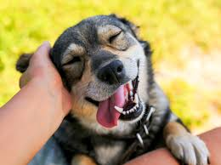
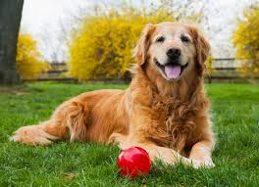
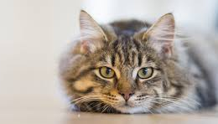
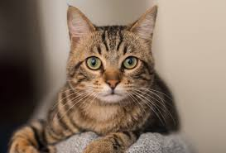
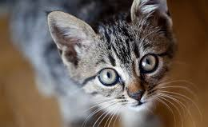
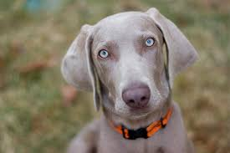

Supervised Learning
=dog
=dog
=cat
=cat
Agent
=cat
=dog
=?

Slide 4
Unsupervised Learning
Agent

Slide 5
Reinforcement Learning
1. Receive Input Information
Agent
Environment
2. Perform valid action
3. Obtain reward

Slide 6
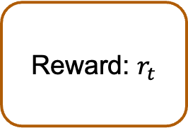
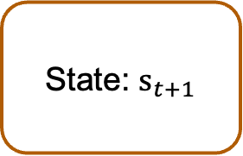

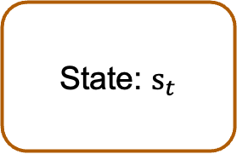
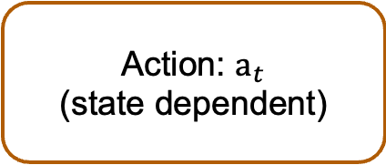
Reinforcement Learning
At time $t$:
1. Receive Input Information
State: $s_{t}$
State: $s_{t+1}$
Agent
2. Perform valid action
Action: $a_{t}$
(state dependent)
3. Obtain reward
Reward: $r_{t}$

Slide 7

















Reinforcement Learning
$$s_{0}$$
$$s_{1}$$
$$s_{2}$$
$$s_{3}$$
$$s_{4}$$
$$s_{5}$$
$$a_{0}$$
$$a_{1}$$
$$a_{2}$$
$$a_{3}$$
$$a_{4}$$
$$a_{5}$$
$$r_{0}$$
$$r_{1}$$
$$r_{2}$$
$$r_{3}$$
$$r_{4}$$
Markov property: next state is determined only based on current action and state, not entire sequence

Slide 8




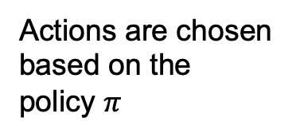













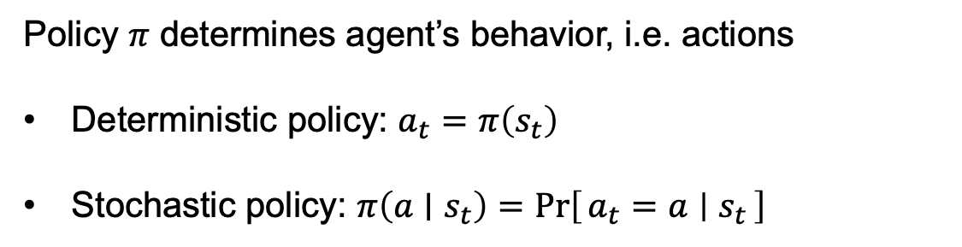
Policy
$$s_{0}$$
$$s_{1}$$
$$s_{2}$$
$$s_{3}$$
$$s_{4}$$
$$s_{5}$$
Actions are chosen based on the policy $π$
$$a_{0}$$
$$a_{1}$$
$$a_{2}$$
$$a_{3}$$
$$a_{4}$$
$$a_{5}$$
$$r_{0}$$
$$r_{1}$$
$$r_{2}$$
$$r_{3}$$
$$r_{4}$$
Policy $π$ determines agent’s behavior, i.e. actions
Deterministic policy: $a_{t}=π\left(s_{t}\right)$
Stochastic policy: $π\left(a∣s_{t}\right)=\operatorname{Pr}\left[a_{t}=a ∣ s_{t}\right]$

Slide 9
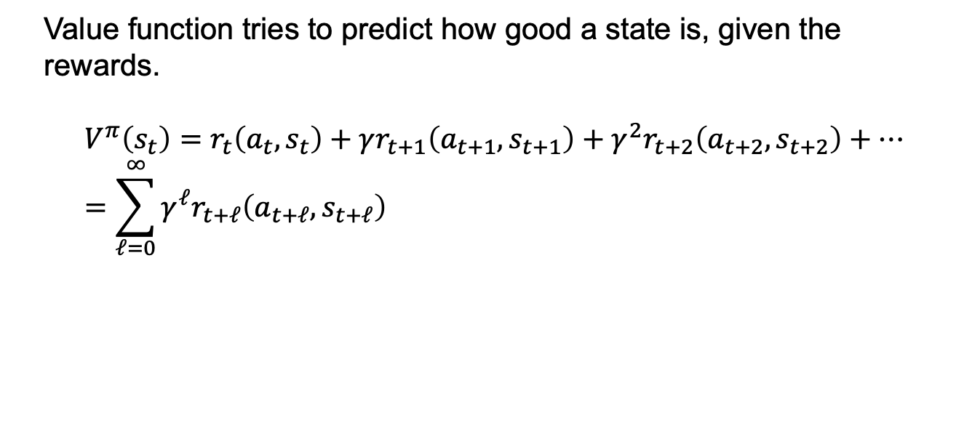
Value Function
$$s_{0}$$
$$s_{1}$$
$$s_{2}$$
$$s_{3}$$
$$s_{4}$$
$$s_{5}$$
Actions are chosen based on the policy $π$
$$a_{0}$$
$$a_{1}$$
$$a_{2}$$
$$a_{3}$$
$$a_{4}$$
$$a_{5}$$
Value function computed based on rewards
$$r_{0}$$
$$r_{1}$$
$$r_{2}$$
$$r_{3}$$
$$r_{4}$$
Value function tries to predict how good a state is, given the rewards.
$$V^{π}\left(s_{t}\right)=r_{t}\left(a_{t},s_{t}\right)+γr_{t+1}\left(a_{t+1},s_{t+1}\right)+γ^{2}r_{t+2}\left(a_{t+2},s_{t+2}\right)+…=\sum_{ℓ=0}^{∞}{γ^{ℓ}r_{t+ℓ}\left(a_{t+ℓ},s_{t+ℓ}\right)}$$

Slide 10
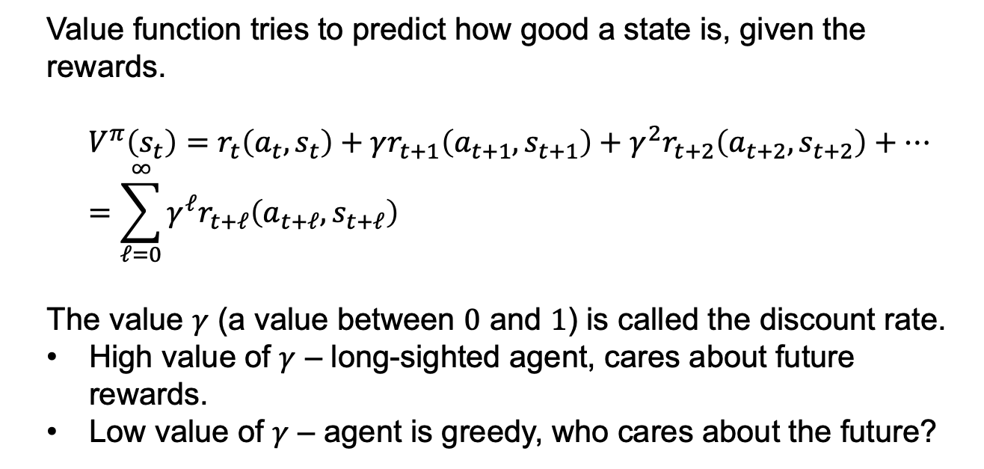
Value Function
Value function tries to predict how good a state is, given the rewards.
$$V^{π}\left(s_{t}\right)=r_{t}\left(a_{t},s_{t}\right)+γr_{t+1}\left(a_{t+1},s_{t+1}\right)+γ^{2}r_{t+2}\left(a_{t+2},s_{t+2}\right)+…=\sum_{ℓ=0}^{∞}{γ^{ℓ}r_{t+ℓ}\left(a_{t+ℓ},s_{t+ℓ}\right)}$$
The value $γ$ (a value between $0$ and $1$) is called the discount rate.
High value of $γ$ – long-sighted agent, cares about future rewards.
Low value of $γ$ – agent is greedy, who cares about the future?

Slide 11
Value Function – The Challenge
We want to choose a value maximizing policy.
However, we are missing two key bits of information:
The rewards of unobserved states.
What the next state will be when we take an action.
The challenge:
Infer rewards/state transitions as we go along
…while maximizing revenue.

Slide 12
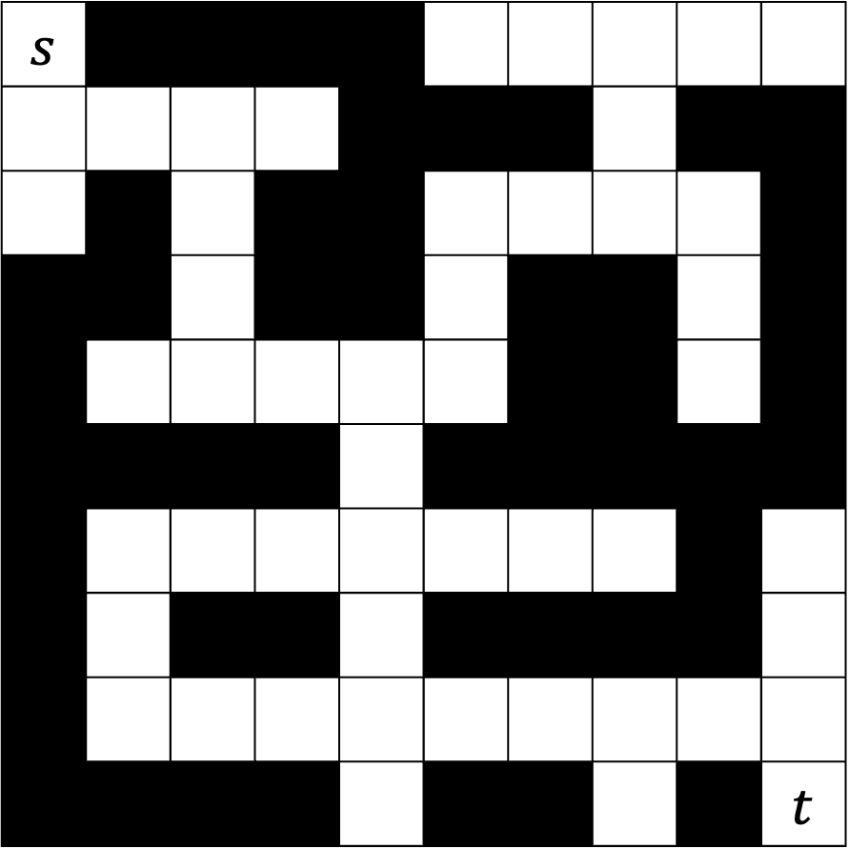
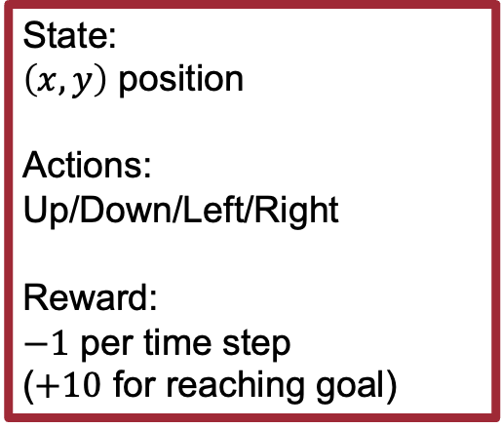
State:
$\left(x,y\right)$ position
Actions:
Up/Down/Left/Right
Reward:
$−1$ per time step
($+10$ for reaching goal)
$$s$$
 |  |  |  |  |  |  |  |  | $$t$$
Policy:
Direction to go from each position (can be randomized).
Value Function:
Total reward of policy execution from given state.

Slide 13
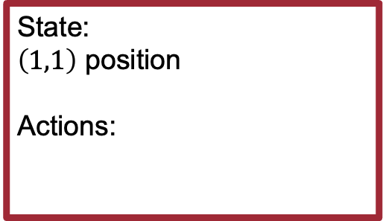
State:
$\left(1,1\right)$ position
Actions:
$$s$$
 |  |  |  |  |  |  |  |  | $$t$$

Slide 14
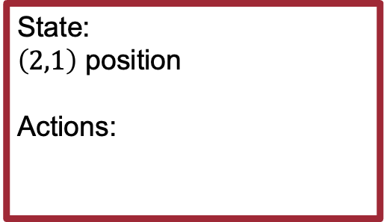
State:
$\left(2,1\right)$ position
Actions:
$$s$$
 |  |  |  |  |  |  |  |  | $$t$$

Slide 15
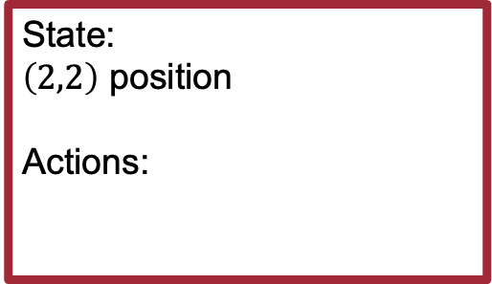
State:
$\left(2,2\right)$ position
Actions:
$$s$$
 |  |  |  |  |  |  |  |  | $$t$$

Slide 16

State:
$\left(2,3\right)$ position
Actions:
$$s$$
 |  |  |  |  |  |  |  |  | $$t$$

Slide 17

State:
$\left(3,3\right)$ position
Actions:
$$s$$
 |  |  |  |  |  |  |  |  | $$t$$

Slide 18

State:
$\left(4,3\right)$ position
Actions:
$$s$$
 |  |  |  |  |  |  |  |  | $$t$$

Slide 19

State:
$\left(5,3\right)$ position
Actions:
$$s$$
 |  |  |  |  |  |  |  |  | $$t$$

Slide 20

State:
$\left(5,4\right)$ position
Actions:
$$s$$
 |  |  |  |  |  |  |  |  | $$t$$

Slide 21

State:
$\left(5,5\right)$ position
Actions:
$$s$$
 |  |  |  |  |  |  |  |  | $$t$$

Slide 22

State:
$\left(5,6\right)$ position
Actions:
$$s$$
 |  |  |  |  |  |  |  |  | $$t$$

Slide 23
$$s$$
 |  |  |  |  |  |  |  |  | $$t$$
Optimal policy:
spend as little time in the maze as possible, get to the goal.

Slide 24

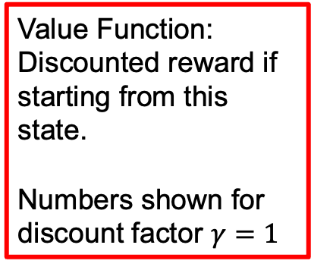
$$−8$$ |  |  |  |  | $$−9$$ | $$−8$$ | $$−7$$ | $$−8$$ | $$−9$$
$$−7$$ | $$−6$$ | $$−5$$ | $$−6$$ |  |  |  | $$−6$$
$$−8$$ |  | $$−4$$ |  |  | $$−3$$ | $$−4$$ | $$−5$$ | $$−6$$
 |  | $$−3$$ |  |  | $$−2$$ |  |  | $$−7$$
 | $$−3$$ | $$−2$$ | $$−1$$ | $$0$$ | $$−1$$ |  |  | $$−8$$
 |  |  |  | $$1$$
 | $$−1$$ | $$0$$ | $$1$$ | $$2$$ | $$1$$ | $$0$$ | $$−1$$ |  | $$7$$
 | $$0$$ |  |  | $$3$$ |  |  |  |  | $$8$$
 | $$1$$ | $$2$$ | $$3$$ | $$4$$ | $$5$$ | $$6$$ | $$7$$ | $$8$$ | $$9$$
 |  |  |  | $$3$$ |  |  | $$6$$ |  | $$10$$
Value Function:
Discounted reward if starting from this state.
Numbers shown for discount factor $γ=1$

Slide 25
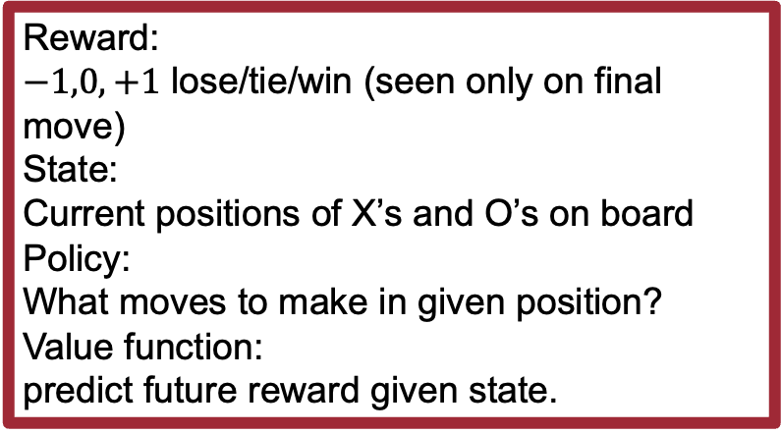
Reward:
$−1,0,+1$ lose/tie/win (seen only on final move)
State:
Current positions of X’s and O’s on board
Policy:
What moves to make in given position?
Value function:
predict future reward given state.
 |  | X
 | X
 | O | O

Slide 26
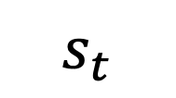
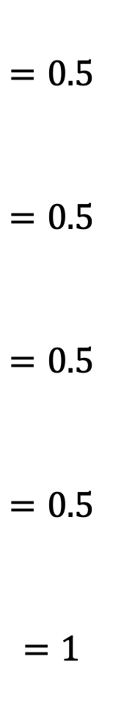
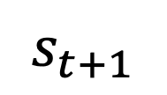
Win Prob.
X |  | X
 | X
 | O | O
$$=0.5$$
$$=0.5$$
$$=0.5$$
$$=0.5$$
$$=1$$
All values are 0/0.5/1 initially
At each turn choose move with highest win prob.
Update table entries based on the game outcome.
Value function will eventually represent true win probabilities
 | X | X
 | X
 | O | O
 |  | X
 | X
 | O | O
 |  | X
X | X
 | O | O
 |  | X
 | X | X
 | O | O
Alternatively:
pick with probability proportional to win prob
make a random choice.
Update strategy is critical:
Necessary for convergence to optimal strategy.
Some will work better than others.
$$s_{t}$$
 |  | X
 | X
X | O | O
$$s_{t+1}$$

Slide 27
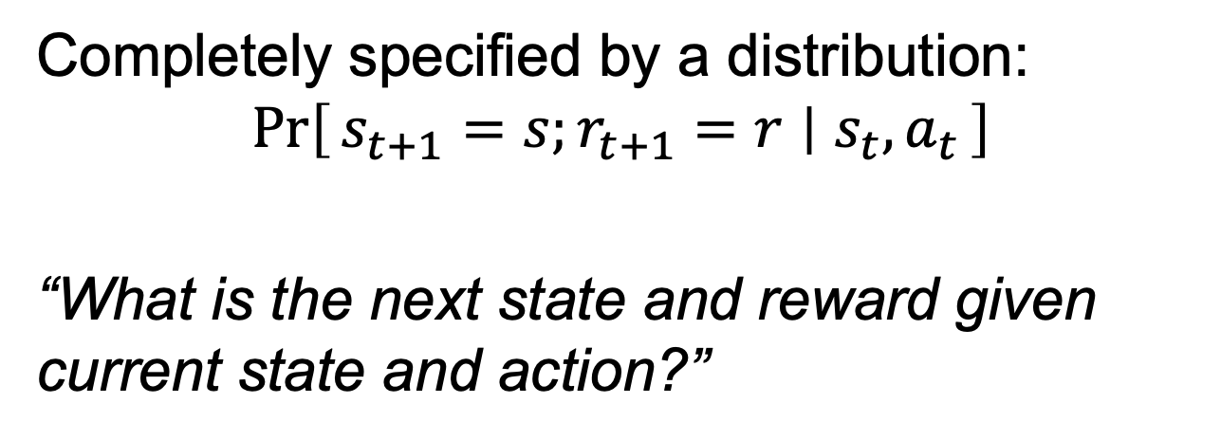
Markov Decision Problem
Completely specified by a distribution:
$$\operatorname{Pr}\left[s_{t+1}=s;r_{t+1}=r ∣ s_{t},a_{t}\right]$$
“What is the next state and reward given current state and action?”
Planning: given an MDP, compute optimal policy
Learning: don’t know the MDP, learn a strategy.

Slide 28
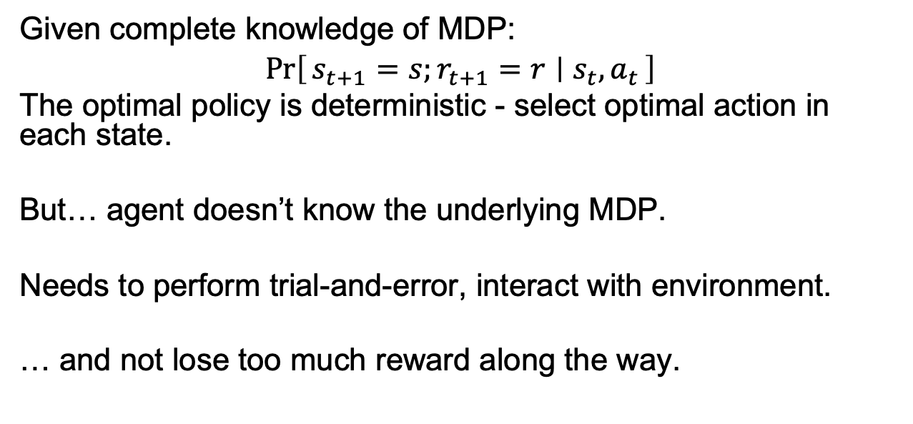
Markov Decision Problem
Given complete knowledge of MDP:
$$\operatorname{Pr}\left[s_{t+1}=s;r_{t+1}=r ∣ s_{t},a_{t}\right]$$
The optimal policy is deterministic - select optimal action in each state.
But… agent doesn’t know the underlying MDP.
Needs to perform trial-and-error, interact with environment.
… and not lose too much reward along the way.

Slide 29
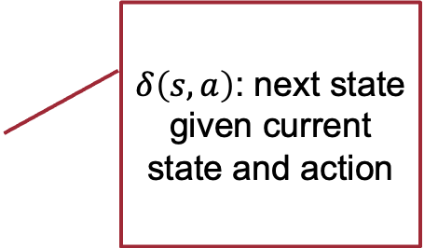
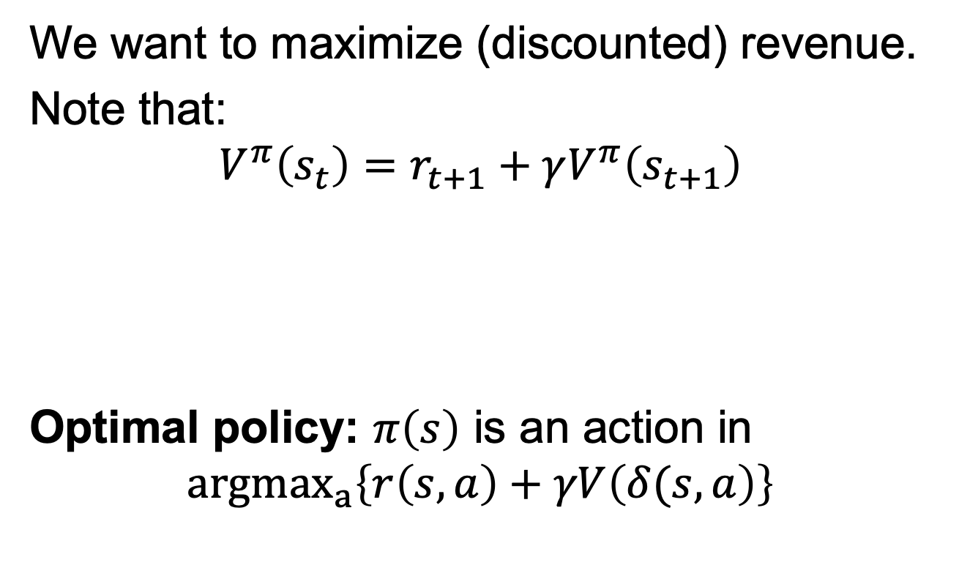
Learning Optimal Policies
We want to maximize (discounted) revenue.
Note that:
$$V^{π}\left(s_{t}\right)=r_{t+1}+γV^{π}\left(s_{t+1}\right)$$
Optimal policy: $π\left(s\right)$ is an action in
$${argmax}_{a}\left\{r\left(s,a\right)+γV\left(δ(s,a\right)\right\}$$
Value now
Reward now
Value later
$δ\left(s,a\right)$: next state given current state and action
Reward now
Value later

Slide 30
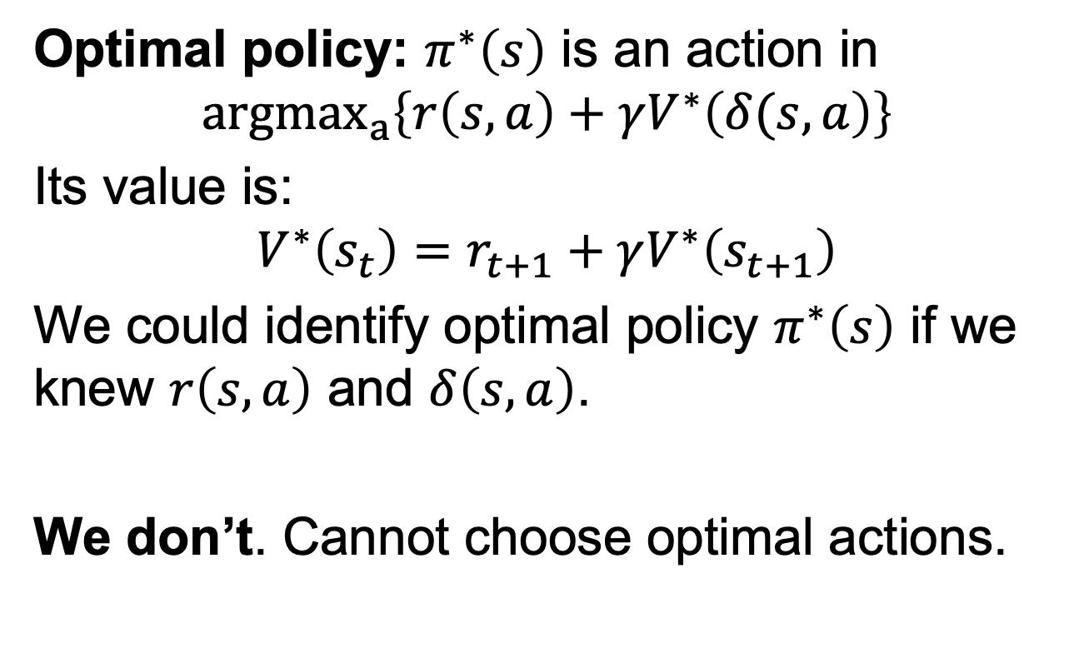
Learning Optimal Policies
Optimal policy: $π^{∗}\left(s\right)$ is an action in
$${argmax}_{a}\left\{r\left(s,a\right)+γV^{∗}\left(δ(s,a\right)\right\}$$
Its value is:
$$V^{∗}\left(s_{t}\right)=r_{t+1}+γV^{∗}\left(s_{t+1}\right)$$
We could identify optimal policy $π^{∗}\left(s\right)$ if we knew $r\left(s,a\right)$ and $δ\left(s,a\right)$.
We don’t. Cannot choose optimal actions.

Slide 31
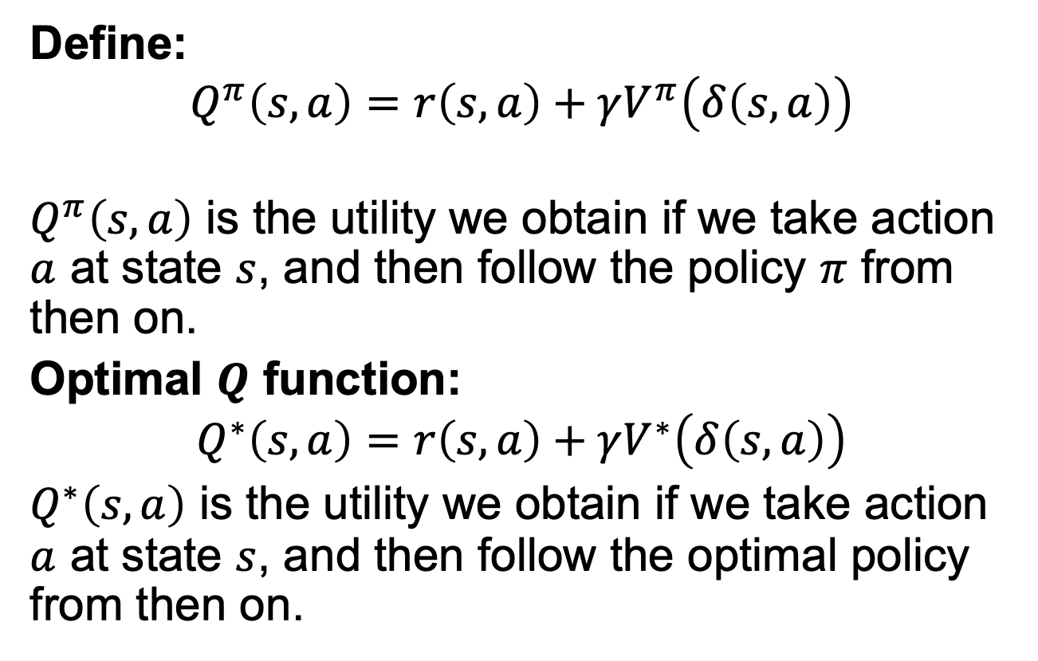
Q-Learning
Define:
$$Q^{π}\left(s,a\right)=r\left(s,a\right)+γV^{π}\left(δ\left(s,a\right)\right)$$
$Q^{π}\left(s,a\right)$ is the utility we obtain if we take action $a$ at state $s$, and then follow the policy $π$ from then on.
Optimal $Q$ function:
$$Q^{∗}\left(s,a\right)=r\left(s,a\right)+γV^{∗}\left(δ\left(s,a\right)\right)$$
$Q^{∗}\left(s,a\right)$ is the utility we obtain if we take action $a$ at state $s$, and then follow the optimal policy from then on.

Slide 32
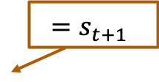
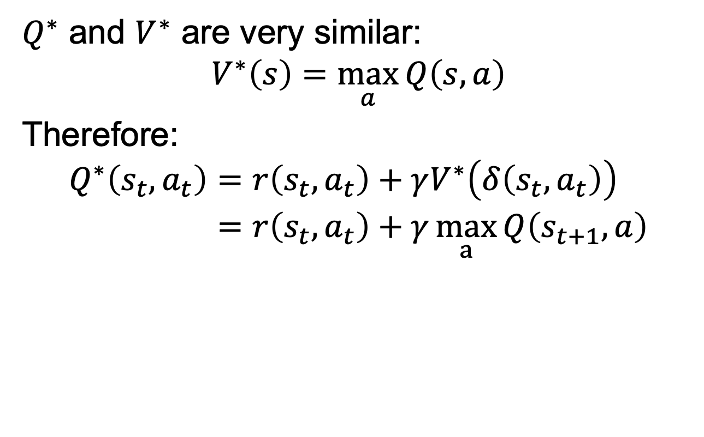
Q-Learning
$Q^{∗}$ and $V^{∗}$ are very similar:
$$V^{∗}\left(s\right)=\max_{a}{Q\left(s,a\right)}$$
Therefore:
$$\begin{aligned}Q^{∗}\left(s_{t},a_{t}\right)&=r\left(s_{t},a_{t}\right)+γV^{∗}\left(δ\left(s_{t},a_{t}\right)\right) \\ &=r\left(s_{t},a_{t}\right)+γ\max_{a}{Q\left(s_{t+1},a\right)}\end{aligned}$$
$$=s_{t+1}$$

Slide 33
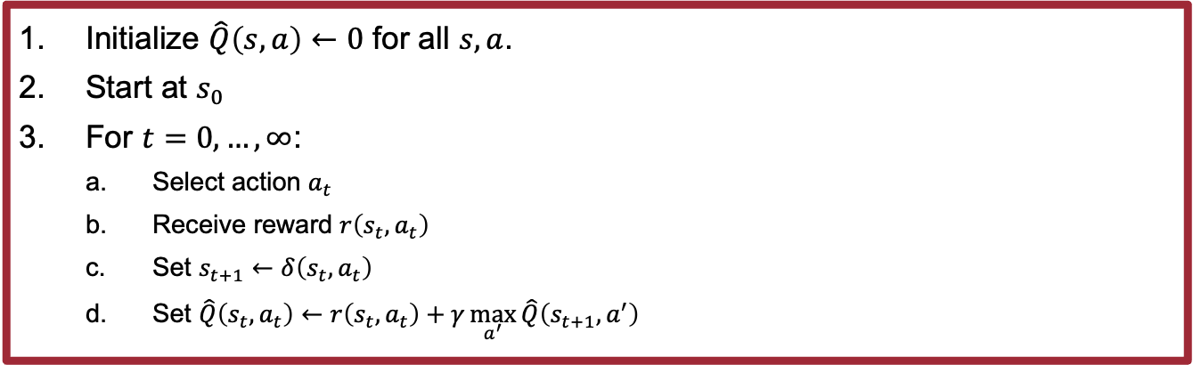
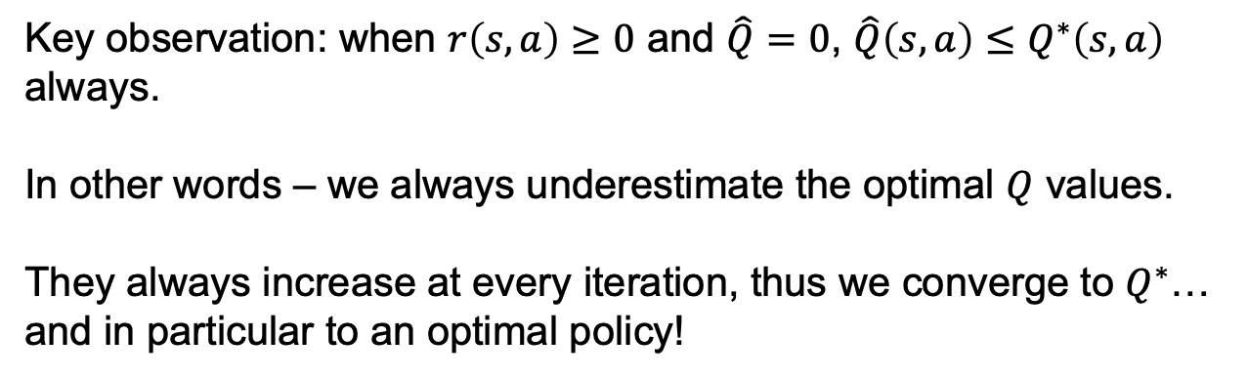
Q-Learning – Value Iteration Algorithm
Initialize $\hat{Q}\left(s,a\right)←0$ for all $s,a$.
Start at $s_{0}$
For $t=0,…,∞$:
  Select action $a_{t}$
  Receive reward $r\left(s_{t},a_{t}\right)$
  Set $s_{t+1}←δ\left(s_{t},a_{t}\right)$
  Set $\hat{Q}\left(s_{t},a_{t}\right)←r\left(s_{t},a_{t}\right)+γ\max_{a^{′}}{\hat{Q}\left(s_{t+1},a^{′}\right)}$
Key observation: when $r\left(s,a\right)≥0$ and $\hat{Q}=0$, $\hat{Q}\left(s,a\right)≤Q^{∗}\left(s,a\right)$ always.
In other words – we always underestimate the optimal $Q$ values.
They always increase at every iteration, thus we converge to $Q^{∗}$… and in particular to an optimal policy!

Slide 34
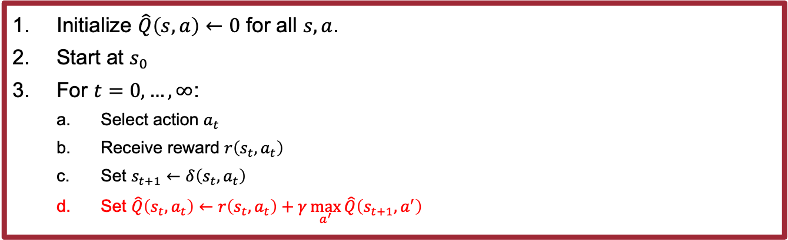
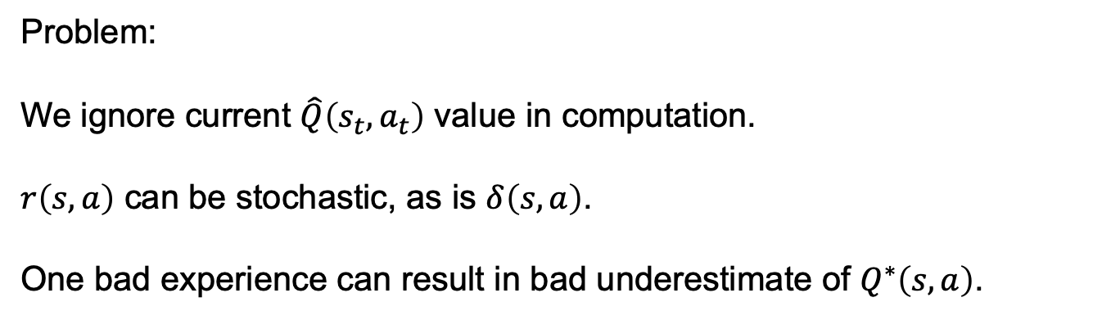
Q-Learning – Value Iteration Algorithm
Initialize $\hat{Q}\left(s,a\right)←0$ for all $s,a$.
Start at $s_{0}$
For $t=0,…,∞$:
  Select action $a_{t}$
  Receive reward $r\left(s_{t},a_{t}\right)$
  Set $s_{t+1}←δ\left(s_{t},a_{t}\right)$
  Set $\hat{Q}\left(s_{t},a_{t}\right)←r\left(s_{t},a_{t}\right)+γ\max_{a^{′}}{\hat{Q}\left(s_{t+1},a^{′}\right)}$
Problem:
We ignore current $\hat{Q}\left(s_{t},a_{t}\right)$ value in computation.
$r\left(s,a\right)$ can be stochastic, as is $δ\left(s,a\right)$.
One bad experience can result in bad underestimate of $Q^{∗}\left(s,a\right)$.

Slide 35
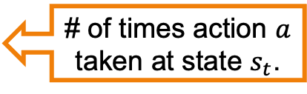
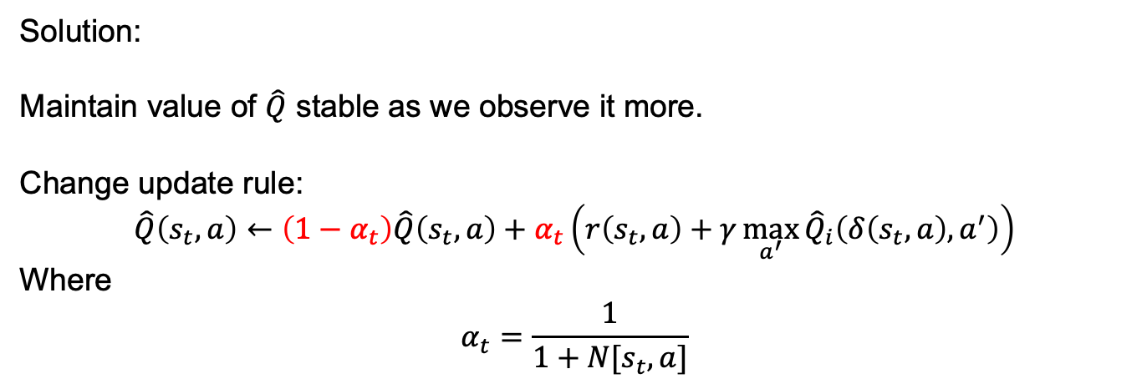
Q-Learning – Value Iteration Algorithm
Initialize $\hat{Q}\left(s,a\right)←0$ for all $s,a$.
Start at $s_{0}$
For $t=0,…,∞$:
  Select action $a_{t}$
  Receive reward $r\left(s_{t},a_{t}\right)$
  Set $s_{t+1}←δ\left(s_{t},a_{t}\right)$
  Set $\hat{Q}\left(s_{t},a_{t}\right)←r\left(s_{t},a_{t}\right)+γ\max_{a^{′}}{\hat{Q}\left(s_{t+1},a^{′}\right)}$
Solution:
Maintain value of $\hat{Q}$ stable as we observe it more.
Change update rule:
$$\hat{Q}\left(s_{t},a\right)←\left(1−α_{t}\right)\hat{Q}\left(s_{t},a\right)+α_{t}\left(r\left(s_{t},a\right)+γ\max_{a^{′}}{{\hat{Q}}_{i}\left(δ\left(s_{t},a\right),a^{′}\right)}\right)$$
Where
$$α_{t}=\frac{1}{1+N[s_{t},a]}$$
# of times action $a$ taken at state $s_{t}$.

Slide 36
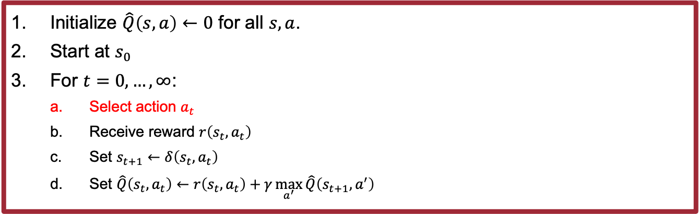
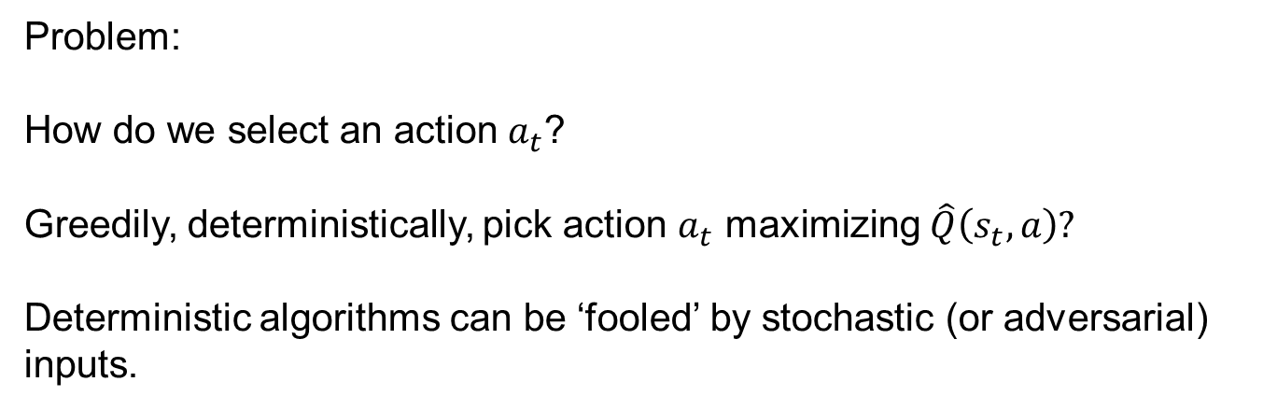
Q-Learning – Value Iteration Algorithm
Initialize $\hat{Q}\left(s,a\right)←0$ for all $s,a$.
Start at $s_{0}$
For $t=0,…,∞$:
  Select action $a_{t}$
  Receive reward $r\left(s_{t},a_{t}\right)$
  Set $s_{t+1}←δ\left(s_{t},a_{t}\right)$
  Set $\hat{Q}\left(s_{t},a_{t}\right)←r\left(s_{t},a_{t}\right)+γ\max_{a^{′}}{\hat{Q}\left(s_{t+1},a^{′}\right)}$
Problem:
How do we select an action $a_{t}$?
Greedily, deterministically, pick action $a_{t}$ maximizing $\hat{Q}\left(s_{t},a\right)?$
Deterministic algorithms can be ‘fooled’ by stochastic (or adversarial) inputs.

Slide 37
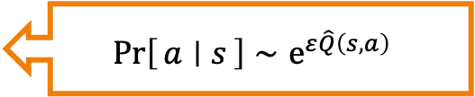
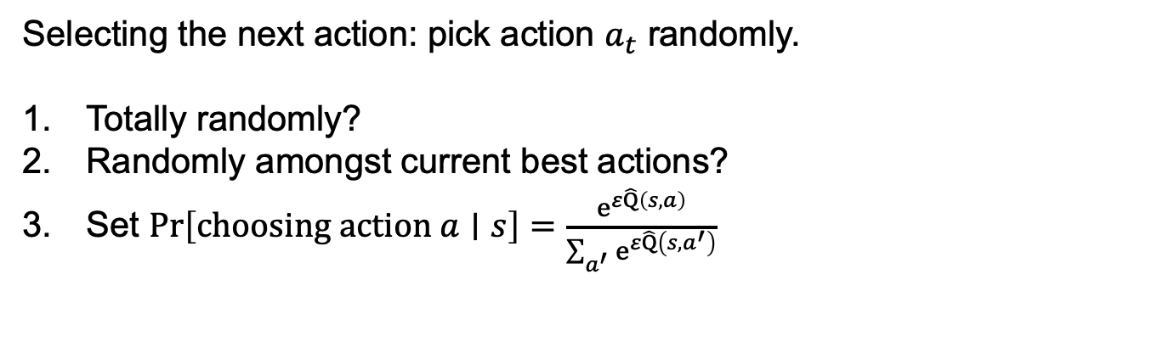
Q-Learning – Value Iteration Algorithm
Initialize $\hat{Q}\left(s,a\right)←0$ for all $s,a$.
Start at $s_{0}$
For $t=0,…,∞$:
  Select action $a_{t}$
  Receive reward $r\left(s_{t},a_{t}\right)$
  Set $s_{t+1}←δ\left(s_{t},a_{t}\right)$
  Set $\hat{Q}\left(s_{t},a_{t}\right)←r\left(s_{t},a_{t}\right)+γ\max_{a^{′}}{\hat{Q}\left(s_{t+1},a^{′}\right)}$
Selecting the next action: pick action $a_{t}$ randomly.
Totally randomly?
Randomly amongst current best actions?
Set $\operatorname{Pr}\left[choosing action a∣s\right]=\frac{e^{ε\hat{Q}\left(s,a\right)}}{\sum_{a^{′}}{e^{ε\hat{Q}\left(s,a^{′}\right)}}}$
$$\operatorname{Pr}\left[a ∣ s\right]∼e^{ε\hat{Q}\left(s,a\right)}$$

